Slide 1
Climate Change and Agriculture -Vulnerability and Impact Analysis
S.Senthilnathan
Assistant Professor
Tamil Nadu Agricultural University

Slide 2
VULNERABILITY ANALYSIS
S. Senthilnathan
Assistant Professor (Agrl. Economics), TNAU
K.Palanisami
Director, IWMI-TATA Water Policy Program, Hyderabad
C.R. Ranganathan
Professor, Mathematics, TNAU

Slide 3
Definitions of Vulnerability
vulnerability has three components (IPCC):
Exposure, Sensitivity and Adaptive capacity.
Exposure can be interpreted as the direct danger (i.e., the stressor), and the nature and extent of changes to a region’s climate variables (e.g., temperature, precipitation, extreme weather events).
Sensitivity describes the human–environmental conditions that can worsen the hazard or trigger an impact.
Adaptive capacity represents the potential to implement adaptation measures that help avert potential impacts (I)
V = I - AC

Slide 4
Construction of Composite Vulnerability Index
Vulnerability to CC is a comprehensive multi-dimensional process influenced by large number of related indicators.
Composite indices are used as yardsticks to gauge the vulnerability of each region to CC.
It helps to classify the sub-regions/districts based on a set of large multivariate data.
The information contained in the large set is transformed into a small set of indices which would provide a convenient method for classification.

Slide 5
Normalization of Indicators using Functional Relationship
When the observed values are related positively to the vulnerability (for eg. higher the variability in rainfall, higher the vulnerability), the standardization is achieved by employing the formula
  y_{id =} (X_{id} – Min X_{id}) / (Max X_{id}- Min X_{id})
When the values are negatively related to the vulnerability (for eg. higher the productivity of a crop, lower the vulnerability)
  y_{id =} (Max_{id} –X_{id}) / (Max X_{id}- Min X_{id})
Index is constructed in such a way that it always lies between 0 and 1 so that it is easy to compare regions.

Slide 6
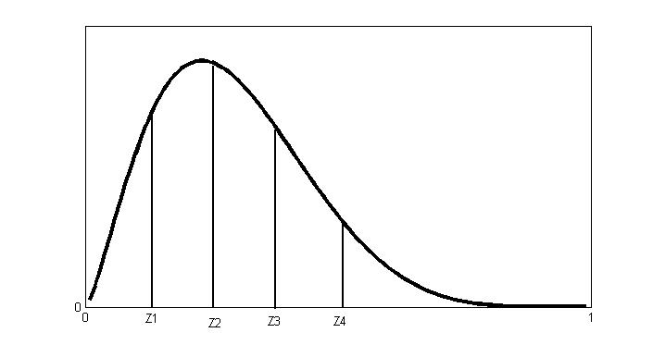
The probability distribution, which is widely used in this context, is the Beta distribution.
The Beta distribution is skewed.
Let and be the linear intervals such that each interval has the same probability weight of 20 per cent.
1. | Less vulnerable | If
2. | Moderately Vulnerable | If
3. | Vulnerable | If
4. | Highly vulnerable | If
5. | Very highly vulnerable | If

Slide 7
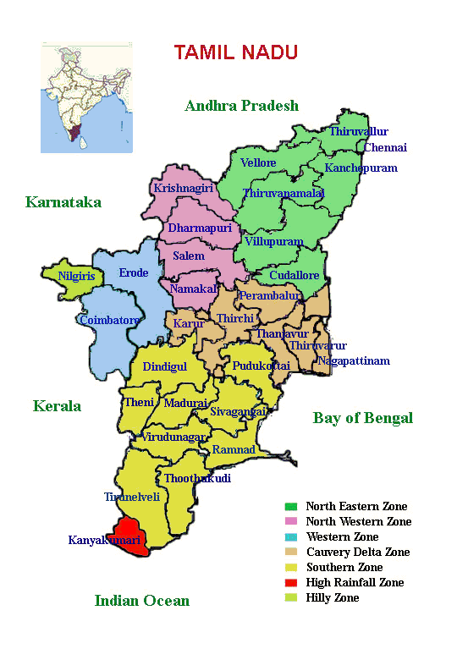
Application to Tamil Nadu State, India

Slide 8
Indicators for calculating Vulnerability Index
Demographic Vulnerability | Climatic Vulnerability | Agricultural Vulnerability | Occupational Vulnerability
1. Density of population Literacy rate | Variance in 1.annual rainfall 2.south west monsoon 3.north east monsoon 4.maximum temperature 5.minimum temperature 6. No. of extreme events (harmful days >35 deg C) | 1. Productivity of major crops 2.Cropping intensity 3.Irrigation intensity 4.Net area sown 5.Livestock population | 1.No of cultivators 2.Agricultural labourers 3. Coastal length (Km)

Slide 9
Vulnerability Index and ranks for
the coastal districts, TN
S. No | Districts | Vulnerability Index | Rank
1 | Thiruvallur | 0.472 | 7
2 | Kancheepuram | 0.491 | 6
3 | Cuddalore | 0.500 | 5
4 | Nagapattinam | 0.545 | 2
5 | Thiruvarur | 0.468 | 8
6 | Tanjore | 0.429 | 10
7 | Pudukkotai | 0.533 | 3
8 | Ramnad | 0.607 | 1
9 | Thoothukudi | 0.515 | 4
10 | Tirunelveli | 0.342 | 11
11 | Kanyakumari | 0.442 | 9

Slide 10
Classification of coastal districts in terms of vulnerability
S. No | Classification | Districts
1 | Less vulnerable | Tanjore, Tirunelveli
2 | Moderately Vulnerable | Thiruvarur, Kanyakumari
3 | Vulnerable | Thiruvallur, Kancheepuram, Cuddalore
4 | Highly vulnerable | Pudukkotai, Thoothukudi
5 | Very high vulnerable | Ramnad, Nagapattinam

Slide 11
Vulnerability Index - Methodology

Slide 12
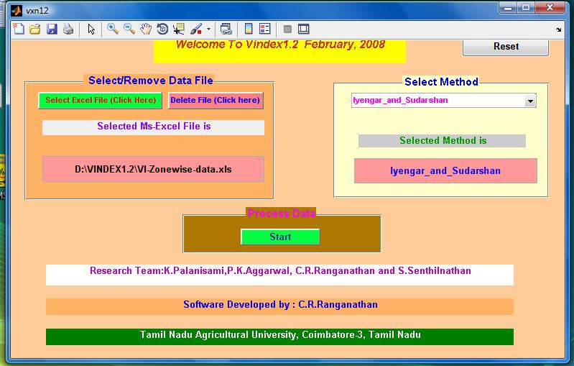
Software for VI

Slide 13
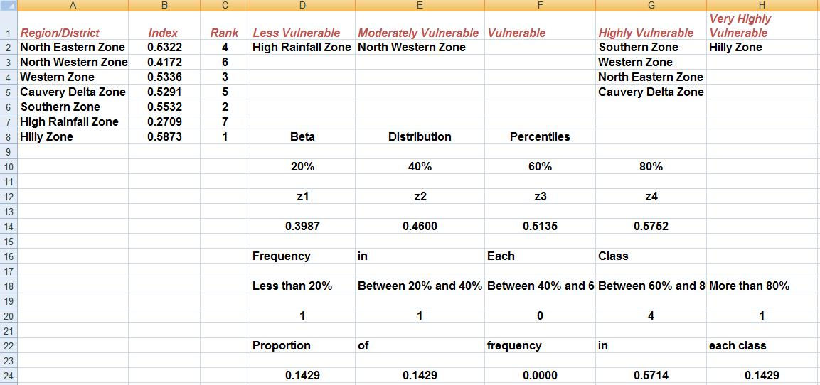
Sample Output - 1

Slide 14
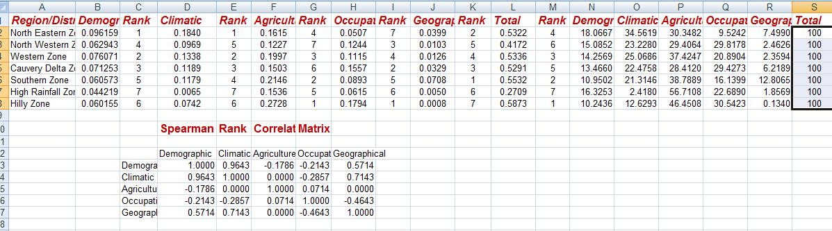
Sample Output-2

Slide 15
A Tutorial on Vulnerability Index Software Package

Slide 16
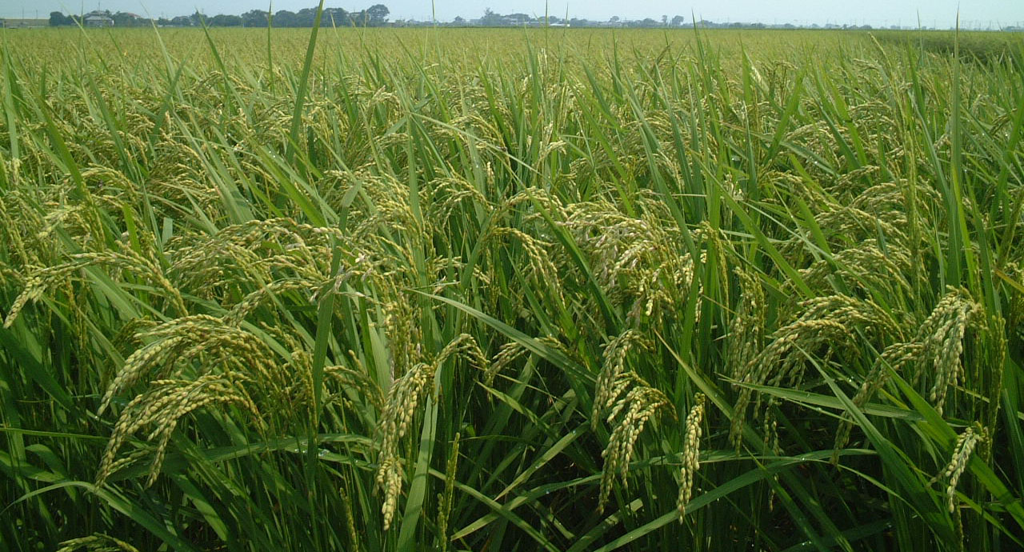
Quantifying the Impact of climate change on Rice production in Tamilnadu
S.SENTHILNATHAN
H.ANNAMALAI
V.PRASANNA
JAN HAFNER
Tamil Nadu Agricultural University, India & IPRC, Hawaii, USA

Slide 17
IPRC Regional climate model output into Applications
To study the possible Impact on Rice production
For current climate
a. with IMD observational data (1989-2008)
b. with ERA-Interim reanalysis data (1989-2008)
c. with IPRC_RegCM forced by ERA-Interim (1989-2008)
d. with IPRC_RegCM forced by GFDL (1981-2000)
For future climate scenarios
a. with IPRC_RegCM forced by GFDL (2021-2050)
b. with IPRC_RegCM forced by GFDL (2081-2100)

Slide 18
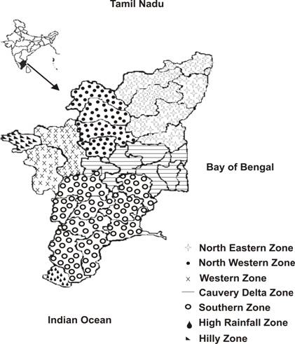
Agro-climatic Zones of Tamilnadu

Slide 19
Agro Economic Model - Ricardian Approach
To assess the climate change induced impact on agriculture, many author used this approach.
Climate change impacts are measured as changes in net revenue or land value (Dinar et al, 1998, Mendelsohn et al., 2001 and Kavikumar, 2003)
The Ricardian model is specified as follows
    R= f(P, T, K)
R is land value/net revenue per hectare
T and P are temperature and precipitation
K represents the control variables such as soil characteristics, literacy, population density etc
Analysis is carried out using pooled cross-sectional, time-series data

Slide 20
Agro-Economic Model
Y = Rice Yield
X_{it} = Economic variables – Labour, fertilizer, irrigation, soil types etc.
W_{it} = Climate variables – Rainfall, Tmax, Tmin and SR
C = Cross-sectional fixed effect
θ = Fixed effects for years
i = Cross-sectional unit
t = Year
β and γ are respective co-efficients

Slide 21
Data Format in Excel
Zone | Year | Rice-Yield | RF | Tmax | Tmin
1 | 1981 | 3180.25 | 479.11 | 30.01 | 16.34
1 | 1982 | 3022.00 | 303.70 | 32.30 | 15.93
1 | 1983 | 3305.25 | 437.98 | 31.66 | 16.53
1 | 1984 | 2713.75 | 39.46 | 34.11 | 15.39
1 | 1985 | 2410.00 | 102.04 | 36.83 | 17.33
1 | 1986 | 3094.40 | 131.91 | 36.50 | 17.77
1 | 1987 | 2855.00 | 25.05 | 35.27 | 16.46
1 | 1988 | 2395.00 | 222.01 | 36.57 | 17.75
1 | 1989 | 3157.17 | 61.68 | 33.81 | 16.10
1 | 1990 | 3484.50 | 70.93 | 36.12 | 17.73
1 | 1991 | 3348.83 | 480.89 | 29.40 | 16.56
1 | 1992 | 3351.33 | 328.09 | 33.30 | 16.44
1 | 1993 | 3472.00 | 165.82 | 33.54 | 16.07
1 | 1994 | 2850.33 | 380.38 | 33.95 | 17.45
1 | 1995 | 2981.17 | 360.80 | 34.19 | 17.53
1 | 1996 | 2931.67 | 20.07 | 35.83 | 16.62
1 | 1997 | 2357.17 | 52.98 | 36.02 | 16.77
1 | 1998 | 3580.00 | 238.23 | 31.91 | 15.83
1 | 1999 | 3339.17 | 592.82 | 30.39 | 16.43
1 | 2000 | 3080.00 | 534.03 | 30.09 | 16.16
2 | 1981 | 3268.00 | 368.51 | 29.54 | 13.72
2 | 1982 | 3200.50 | 150.95 | 32.13 | 13.41
2 | 1983 | 3212.50 | 290.92 | 31.17 | 14.15
2 | 1984 | 2779.00 | 9.32 | 34.42 | 13.04
2 | 1985 | 3235.50 | 131.06 | 37.09 | 15.70
2 | 1986 | 3634.50 | 132.79 | 36.76 | 15.94
2 | 1987 | 3739.50 | 35.75 | 35.27 | 14.30
2 | 1988 | 3453.00 | 230.50 | 36.83 | 15.96
2 | 1989 | 3907.67 | 20.88 | 33.97 | 13.89

Slide 22
Regression Output
SUMMARY OUTPUT
Regression Statistics
Multiple R | 0.509907
R Square | 0.260005
Adjusted R Square | 0.240867
Standard Error | 540.8844
Observations | 120
ANOVA
 | df | SS | MS | F | Significance F
Regression | 3 | 11923923 | 3974641 | 13.58592 | 1.17E-07
Residual | 116 | 33936484 | 292555.9
Total | 119 | 45860407
 | Coefficients | Standard Error | t Stat | P-value | Lower 95% | Upper 95% | Lower 95.0% | Upper 95.0%
Intercept | 8155.139 | 993.1936 | 8.211026 | 3.46E-13 | 6187.994 | 10122.28 | 6187.994 | 10122.28
RF | -1.03638 | 0.432511 | -2.3962 | 0.018165 | -1.89303 | -0.17974 | -1.89303 | -0.17974
Tmax | -139.618 | 23.35528 | -5.978 | 2.55E-08 | -185.876 | -93.3598 | -185.876 | -93.3598
Tmin | -1.24916 | 20.19411 | -0.06186 | 0.950783 | -41.2461 | 38.74783 | -41.2461 | 38.74783

Slide 23
Variables | Coefficients | GFDL-Baseline | TN | GFDL- 2050 | TN | GFDL-2100 | TN
Constant | 8155.14
RF | -1.0364 | RF | 173.86 | RF | 421.94 | RF | 361.83
Tmax | -139.6179 | Tmax | 32.89 | Tmax | 33.63 | Tmax | 36.68
Tmin | -1.2492 | Tmin | 17.16 | Tmin | 19.20 | Tmin | 21.35
Ybase = 8155.14 + (-1.0364*173.86) + (-139.617*32.89) + (-1.249*17.16) = 3361.15 Y2050 = 8155.14 + (-1.0364*421.94) + (-139.617*33.63) + (-1.249*19.20) = 2998.95 Y2100 = 8155.14 + (-1.0364*361.83) + (-139.617*36.68) + (-1.249*21.35) = 2632.79 Year Yield change (Kg/ha) % change 2050 362.19 10.78 2100 728.35 21.67

Slide 24
Data Format in Excel
Zone | Year | Rice-Yield | RF | Tmax | Tmin | Z1 | Z2 | Z3 | Z4 | Z5 | Z6
1 | 1981 | 3180.25 | 479.11 | 30.01 | 16.34 | 1 | 0 | 0 | 0 | 0 | 0
1 | 1982 | 3022.00 | 303.70 | 32.30 | 15.93 | 1 | 0 | 0 | 0 | 0 | 0
1 | 1983 | 3305.25 | 437.98 | 31.66 | 16.53 | 1 | 0 | 0 | 0 | 0 | 0
1 | 1984 | 2713.75 | 39.46 | 34.11 | 15.39 | 1 | 0 | 0 | 0 | 0 | 0
1 | 1985 | 2410.00 | 102.04 | 36.83 | 17.33 | 1 | 0 | 0 | 0 | 0 | 0
1 | 1986 | 3094.40 | 131.91 | 36.50 | 17.77 | 1 | 0 | 0 | 0 | 0 | 0
1 | 1987 | 2855.00 | 25.05 | 35.27 | 16.46 | 1 | 0 | 0 | 0 | 0 | 0
1 | 1988 | 2395.00 | 222.01 | 36.57 | 17.75 | 1 | 0 | 0 | 0 | 0 | 0
1 | 1989 | 3157.17 | 61.68 | 33.81 | 16.10 | 1 | 0 | 0 | 0 | 0 | 0
1 | 1990 | 3484.50 | 70.93 | 36.12 | 17.73 | 1 | 0 | 0 | 0 | 0 | 0
1 | 1991 | 3348.83 | 480.89 | 29.40 | 16.56 | 1 | 0 | 0 | 0 | 0 | 0
1 | 1992 | 3351.33 | 328.09 | 33.30 | 16.44 | 1 | 0 | 0 | 0 | 0 | 0
1 | 1993 | 3472.00 | 165.82 | 33.54 | 16.07 | 1 | 0 | 0 | 0 | 0 | 0
1 | 1994 | 2850.33 | 380.38 | 33.95 | 17.45 | 1 | 0 | 0 | 0 | 0 | 0
1 | 1995 | 2981.17 | 360.80 | 34.19 | 17.53 | 1 | 0 | 0 | 0 | 0 | 0
1 | 1996 | 2931.67 | 20.07 | 35.83 | 16.62 | 1 | 0 | 0 | 0 | 0 | 0
1 | 1997 | 2357.17 | 52.98 | 36.02 | 16.77 | 1 | 0 | 0 | 0 | 0 | 0
1 | 1998 | 3580.00 | 238.23 | 31.91 | 15.83 | 1 | 0 | 0 | 0 | 0 | 0
1 | 1999 | 3339.17 | 592.82 | 30.39 | 16.43 | 1 | 0 | 0 | 0 | 0 | 0
1 | 2000 | 3080.00 | 534.03 | 30.09 | 16.16 | 1 | 0 | 0 | 0 | 0 | 0
2 | 1981 | 3268.00 | 368.51 | 29.54 | 13.72 | 0 | 1 | 0 | 0 | 0 | 0
2 | 1982 | 3200.50 | 150.95 | 32.13 | 13.41 | 0 | 1 | 0 | 0 | 0 | 0
2 | 1983 | 3212.50 | 290.92 | 31.17 | 14.15 | 0 | 1 | 0 | 0 | 0 | 0
2 | 1984 | 2779.00 | 9.32 | 34.42 | 13.04 | 0 | 1 | 0 | 0 | 0 | 0
2 | 1985 | 3235.50 | 131.06 | 37.09 | 15.70 | 0 | 1 | 0 | 0 | 0 | 0
2 | 1986 | 3634.50 | 132.79 | 36.76 | 15.94 | 0 | 1 | 0 | 0 | 0 | 0
2 | 1987 | 3739.50 | 35.75 | 35.27 | 14.30 | 0 | 1 | 0 | 0 | 0 | 0
2 | 1988 | 3453.00 | 230.50 | 36.83 | 15.96 | 0 | 1 | 0 | 0 | 0 | 0
2 | 1989 | 3907.67 | 20.88 | 33.97 | 13.89 | 0 | 1 | 0 | 0 | 0 | 0

Slide 25
Prediction
Variables | Coefficients | GFDL-Baseline-Zone-Avgs | 1.00 | 2.00 | 3.00 | 4.00 | 5.00 | 6.00
Constant | 6322.17 |  | 1.00 | 1.00 | 1.00 | 1.00 | 1.00 | 1.00
RF | 0.38 | GFDL Base-RF | 251.40 | 191.25 | 185.75 | 175.12 | 152.36 | 87.27
Tmax | -26.11 | GFDL Base-Tmax | 33.59 | 33.56 | 32.25 | 34.65 | 32.86 | 30.45
Tmin | -71.85 | GFDL Base-Tmin | 16.66 | 14.49 | 14.58 | 16.79 | 18.11 | 22.32
Zone-1 | -1299.35
Zone-2 | -920.47
Zone-3 | -862.76
Zone-4 | -1533.45
Zone-5 | -1001.14
Zone-6 | 0.00
Zone | Zone 1 | Zone 2 | Zone 3 | Zone 4 | Zone 5 | Zone 6 | TN
GFDL-Baseline | 3045.45 | 3558.17 | 3641.20 | 2745.14 | 3220.37 | 3956.55 | 3361.15
GFDL- 2050 | 2971.22 | 3489.78 | 3586.14 | 2648.28 | 3116.40 | 3933.46 | 3290.88
GFDL- 2100 | 2724.61 | 3231.63 | 3330.91 | 2394.11 | 2852.69 | 3667.28 | 3033.54
Yield Change | Z1 | Z2 | Z3 | Z4 | Z5 | Z6
Baseline | 3045.45 | 3558.17 | 3641.20 | 2745.14 | 3220.37 | 3956.55
GFDL50 | -74.23 | -68.39 | -55.06 | -96.86 | -103.97 | -23.09
GFDL100 | -320.84 | -326.54 | -310.29 | -351.02 | -367.69 | -289.27
% change-2050 | 2.44 | 1.92 | 1.51 | 3.53 | 3.23 | 0.58
% change-2100 | 10.53 | 9.18 | 8.52 | 12.79 | 11.42 | 7.31

Slide 26
Impact Analysis - Methodology

Slide 27
Thank you

